Slide 1
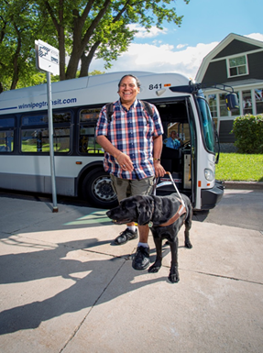

Winnipeg Transit Plus
Winnipeg Transit Master Plan
Customer
Discussion
January 13, 2020
January 14, 2020

Slide 2
Agenda
Overview and purpose
Program Overview
Select Topics and Policy Analysis
Initial Recommendations

Slide 3
About Winnipeg Transit
A modern Winnipeg Transit that provides accessible mobility options for all residents
Different options for different abilities and trips
Conventional Services:
    Provides service throughout the City and the network is undergoing a review
    Buses are low-floor and have accessibility features
    Winnipeg Transit and City expanding accessibility of key bus stops and stations
Transit Plus:
    Door-to-door transportation for persons unable to complete their journey using conventional services
    Opportunity to reshape the program to better serve customers

Slide 4
About Transit Plus
Service for persons with disabilities and mobility challenges
Provided nearly 400,000 door-to-door trips in 2018
Trip requests are made ahead of time by calling Transit Plus and booking the trip
Customers must satisfy eligibility requirements to qualify for Transit Plus service

Slide 5
Purpose of our review
Evaluate how Transit Plus is doing and compare to best practices in North America
Respond to main findings of Ombudsman’s Report
  Assess eligibility criteria, trip prioritization and no-show policies; contrast with industry best practices
Align with upcoming Accessibility for Manitobans Act (AMA) legislation related to transportation
Modernize the program by making it equitable and sustainable for those who truly need it
Integrate accessible conventional fixed route services into our service delivery strategy

Slide 6
Setting the Context

Slide 7
Framing our discussion
Winnipeg’s population is aging
Ridership and demand for Transit Plus services is growing exponentially
We need to comply with new Accessibility for Manitobans Act legislation
  Remove and prevent barriers to accessibility
The need to update Transit Plus for equity and based on our changing society

Slide 8
Accessibility for Manitobans Act (AMA)

Slide 9
The Accessibility for Manitobans Act (1/2)
Passed in December 2013 to proactively plan for accessibility, remove and prevent barriers
Transportation Accessibility Standard Discussion Paper released in October 2019
    Not yet proclaimed into legislation
This includes elements like:
  Accessible vehicles, with features like priority seating, mobility device securements, grab bars, etc.
  Fares that are the same as conventional services
  Pre-boarding, on-board, and other auditory announcements
  Lighting and signage that is appropriate for persons with low-vision
  Accessibility training for staff when providing service to persons with disabilities
  Accessible information, such as large type maps, high-visibility information

Slide 10
The Accessibility for Manitobans Act (2/2)
Also directly impacts:
  Eligibility – three new categories
    Unconditional – unable to use conventional services for all trips
    Conditional – able to use conventional services for some trips
    Temporary – unable to use conventional services for a limited period of time
  Booking – provides for same day service requests, or up to three hours before end service on day before travel
  Trip prioritization – eliminate trip prioritization and trip restrictions
Winnipeg Transit Plus participated in developing and shaping the transportation standard to protect its customers

Slide 11
Modernizing Winnipeg Transit Plus

Slide 12
A modern, equitable, and accessible service
Winnipeg Transit Plus recently rebranded from previous Handi-Transit
We need to go further—society has changed, our norms have shifted, we need to respect everyone and provide equitable service
  Go beyond complying with Accessibility for Manitobans Act
Important aspects to consider beyond Accessibility for Manitobans Act
  No show policy—current outdated and a cash penalty is not what most transit agencies do
  Family of Services delivery—combining conventional and Transit Plus service to enable freedom, flexibility and dignity
  Lowering the cost of service by using all available transportation options—Transit Plus can be the go-between or coordinator to find the necessary transportation, regardless of the transportation provider

Slide 13
Eligibility

Slide 14
Current eligibility criteria
Prevailing eligibility criteria were approved and adopted by City of Winnipeg council on April 26, 2006, and later modified in 2010 to include Alzheimer’s Disease and Related Dementias, and serve as the basis for eligibility determinations:
1. Requires the use of a wheelchair or scooter
2. Unable to walk 175 metres (575 feet) outside
3. Has 20/200 vision or less, or a visual field of less than 20 degrees in both eyes (legally blind) not corrected by lenses
4. Has Alzheimer’s Disease and Related Dementias (ADRD) which interferes with the ability to use the regular conventional transit system with an equivalent level of independence and safety (assessment of cognitive ability to use public transit required).

Slide 15
Current eligibility categories
Individuals are required to undergo a functional assessment
Based on eligibility and assessment, individuals accepted are categorized as:
  Unconditional – able to use Transit Plus for all trips
  Seasonal – able to use Transit Plus during winter months only (October 15 through April 15)
  Temporary – able to use Transit Plus for a limited period based on a temporary medical condition (e.g. hip replacement) or for dialysis treatment
The table below shows a breakdown of eligibility categories
Eligibility Category | Number of customers | Percentage of total customer base
Unconditional (3-Year Rolling Term) | 6,454 | 86%
Seasonal (Winter Only) | 260 | 4%
Dialysis Only | 265 | 3%
Temporary | 432 | 6%
Alzheimer’s Disease and Related Dementias | 82 | 1%
Total Customers | 7,493 | 100%

Slide 16
Assessment of current eligibility practices (1/2)
Transit Plus processes and policies no longer align with industry best practices
Designed at time when infrastructure and vehicles were not physically accessible – but that has started to change
“Blanket approach” to all persons with disabilities and mobility challenges
Does not fully take into account a person’s level of ability which many have varying degrees
Current eligibility criteria exacerbates demand
  Use of wheelchair = “automatic” unlimited eligibility
  Vision impaired = “automatic” unlimited eligibility

Slide 17
Assessment of current eligibility practices (2/2)
Does little to keep the program equitable and sustainable
  Opportunity to align eligibility with effectively providing service and upcoming legislation
Focus on the ability to use conventional services together with Transit Plus
Consider how to work with other transportation providers in Winnipeg where overlapping situations present
Enabling barrier-free lifestyles needs to be the future

Slide 18
Trip Prioritization

Slide 19
Trip prioritization
Priority Ranking | Trip Purpose
Priority 1 | Work, medical, education, therapy and transportation terminal (airport/bus terminal)
Priority 2 | Essential shopping, support groups, self-development courses, personal business, advance ticket events, other prescribed therapy, religious services and volunteer work
Priority 3 | Recreational activity, grooming, dining out, shopping (non-essential), and all other trip purposes
Outdated practice that creates difficult situations
Discriminatory practice this is not fair and equitable
Goes against City of Winnipeg’s 2011 policy framework which is based on mobility for all Winnipeggers
The pending legislation won’t allow it
Properly functioning eligibility process regulates the demand for service
Practice needs to be eliminated

Slide 20
No-Show Policy

Slide 21
No-Show Policy
Commonplace across North America to ensure that service is not abused and available for customers who truly need it
No-show at Transit Plus when a customer:
  Cancels a trip within 30-minutes of scheduled pick-up → late cancellation
  Cancels or refuses a trip when the operator or vehicle arrives → cancellation at the door
  Is not ready for the pick-up
  Has too many parcels to accommodate or cannot be safely secured in the vehicle

Slide 22
No-Show Repercussions
Each no-show incident results in a letter explaining the incident, and fines are charged as a customer accumulates more no-shows (within 6 months)
In 2015, Transit Plus collected $28,201 in charges related to no-shows.
No-shows were a major complaint in the Ombudsman’s Report
Incident | Penalty
1st no-show | No charge
2nd no-show | The equivalent of one fare
3rd no-show | The equivalent of two fares
4th no-show | The equivalent of three fares
5th and further no-shows | $15

Slide 23
Peer No-Show Policies
York Region Transit Mobility Plus
Graduated ‘demerit’ point scheme
For cancellations within 2-hours of pick-up
Late cancellation – 1 pt; no-show or at the door cancellation – 2 pts
12 points, 2-day suspension; 30 points, 60-day suspension and phone interview to review service needs
No financial penalties
Toronto Transit Commission Wheel-Trans
Late cancellation within 4-hours of pick-up
‘Life Happens Points’ – provides each customer with 8 points
Late cancellation – 1 pt; no-show and cancel-at-the-door – 2pts.
Using all points within a 6-month –twice results in a 7-day suspension; four times results in 30-day suspension
No financial penalties

Slide 24
Peer No-Show Policies
New York City Transit Access-A-Ride
Customers have 7 points each month
No-show if customer doesn’t board within 5-minutes – 1 point
Late cancellation within 2-hours of its scheduled pick-up – 1 point
Multiple violations (running out of points) results in suspension
No financial penalties
Grand River Transit (Waterloo, Ontario)
GRT provides a clear explanation of no-shows and why no-shows need to be addressed
Similar definition to Transit Plus
Three occurrences in one month violates policy, next time results in a one-month suspension
No financial penalties

Slide 25
No-show summary
Point-based systems are most common
All point-based systems involve service suspensions for repeated no shows or cancellations
Financial penalties are now uncommon

Slide 26
Considerations for Transit Plus
Eliminate financial penalty – it is not changing behaviour
Increase allowance for number of no-shows over a defined time period (one ‘freebie’ within 6 months is too restrictive)
Expand cancellation window to 2 hours to align with industry norms and improve unaccommodated rate – ride cannot be redirected within 30 minutes of a cancellation
Clarify no-show appeal process to be transparent

Slide 27
Booking Times and Trip Delivery

Slide 28
Current requests and delivery
When a customer requests a trip, an exact pick-up time is given
This provides unrealistic expectations due to traffic and other conditions:
  Impacts customer satisfaction
  Clogs the call centre line with customers checking on their trip (and reduces the ability to book new trips for other customers)
  Reduces the ability to share trips

Slide 29
Considerations for trip requests and delivery
Most peers use a booking window
  Customers are provided a 30-minute time frame of when to be ready for pick-up (i.e., please be ready between 11-11:30 am)
  When the vehicle arrives, a pick-up window allows the customer 5-minutes to get ready (i.e., if the vehicle arrives at 11:10 am, the passenger has until 11:15 am to meet the driver)
This will impact the no-show policy

Slide 30
The Family of Services
Empowering Mobility with Accessible Conventional Transit

Slide 31
Family of Services – Mobility On Your Schedule
Uses the investment in accessible infrastructure on conventional service to combine paratransit and conventional modes to deliver journeys
Uses trip-by-trip eligibility, particularly conditional eligibility, to ensure that costly door-to-door service is used when truly required
Same day service guaranteed if FOS trip requested
Increases the flexibility and freedom to travel since it reduces the need to rely only on door-to-door
Image source: TTC

Slide 32
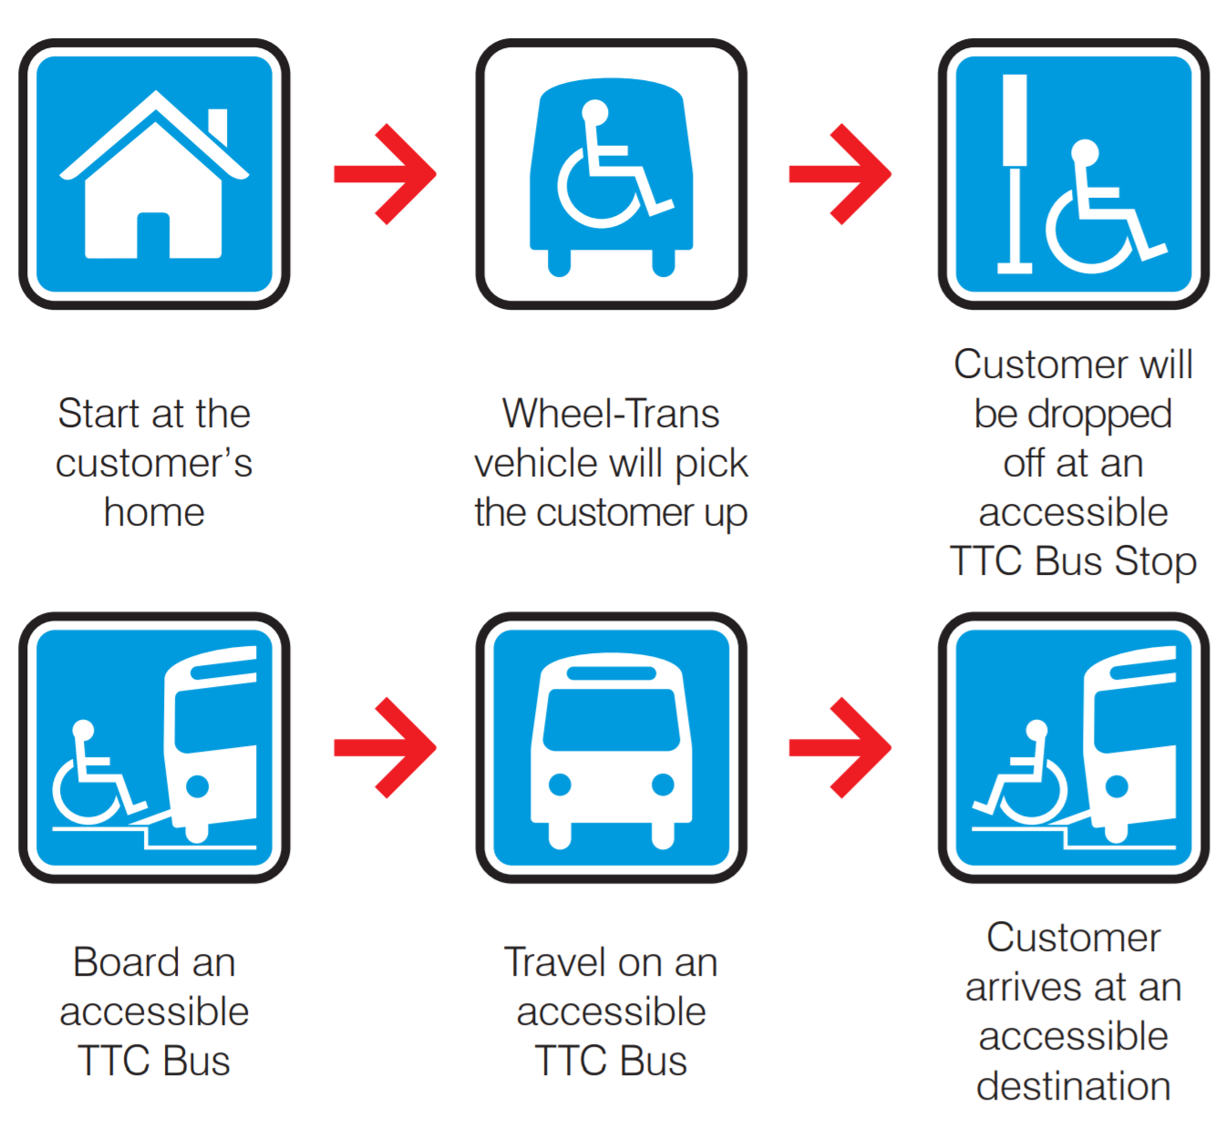
Case Study – Family of Services, Toronto

Slide 33
Case Study – Family of Services, Toronto
Match right service to the customer
Driver assistance from door to door
Deliver 13, 000 door-to-door trips per day
Goal by 2025 that 50% of trips be delivered by FOS
All modes of conventional transit are used – bus, subway and streetcar
Many champions have emerged

Slide 34
Family of Services – Opportunities
Travel training – teaching independence and empowering individuals to use accessible conventional transit service
Comingling – more efficient use of Transit Plus vehicles and resources to transport Winnipeggers of all abilities on the same vehicle. This improves efficiency and effectiveness.
  Requires customers booking a trip, like Transit Plus, and could be used to connect with high-frequency conventional service

Slide 35
Family of Services – Challenges
Insufficient wheelchair securements on conventional bus fleet needs to be addressed
Not all bus stops are accessible
Inadequate sidewalk network in parts of the city
Ice, snow and winter weather
Internal and external buy-in
Trip scheduling and coordinating transfers between services

Slide 36
Recommendations

Slide 37
Early Action Items (1/2)
Time Frame — Within one year
Eliminate trip prioritization – Not compliant with legislation and not equitable
Change the no-show policy
    Provide an allowable number of no-shows within a rolling time frame
    Adopt a 2-hour no-show window
    Provide education and information about no-show policy
    Develop a clear list of what is a no-show to clarify the appeal process
Implement booking and trip delivery windows
    Provide a 20-minute time window
    Provide a 5-minute pick-up window

Slide 38
Early Action Items (2/2)
Time Frame — Within one year
Implement fare parity – offer the same fares and fare products as conventional services
Develop an Accessible Transit Tactical Implementation Plan – to develop an action plan to implement Accessibility for Manitobans Act regulations, and recommendations from this study

Slide 39
Mid-Term Action Items
Time Frame — 1 to 2 years from now
Revise eligibility categories to be consistent with legislation and best practices
Update eligibility criteria to be consistent with best practices
Expand service boundary to the city boundaries of Winnipeg—not only within 500 metres of a bus stop

Slide 40
Long-Term Action Items
Time Frame — 3 to 5 years from now
Recertify all existing customers as per the new categories and criteria—this would happen over a 3-year period
Adopt a Family of Services delivery model
Expand Travel Training program
Investigate feasibility of providing only return trips from dialysis appointments
Transition to a model whereby Transit Plus is a mobility coordinator that matches all transportation options with customers (such as volunteer programs, hospital transport, etc.)

Slide 41
Questions and discussion

